Slide 1


YouTube Transcript Summarizer

Slide 2
Contents
Introduction
Requirements
Stages
Features
Interface
Output

Slide 3

Introduction
‘YouTube Transcript Summarizer’ is a Chrome Extension that allows users to get a ‘summarized’ version of the transcripts of YouTube videos with a ‘single click’. It utilizes Natural Language Processing (NLP) algorithms such as ‘Latent Semantic Analysis’ (LSA) and ‘state-of-the-art Huggingface Transformer models’ to efficiently summarize the transcripts of YouTube videos with a single click. It is built on a ‘Flask Backend REST API’ to expose the summarization service to the client.

Slide 4

Requirements
flask
youtube_transcript_api
transformers
sentencepiece
Scikit-learn
langdetect
nltk
numpy
PyTorch
Tensorflow
Flax

Slide 5
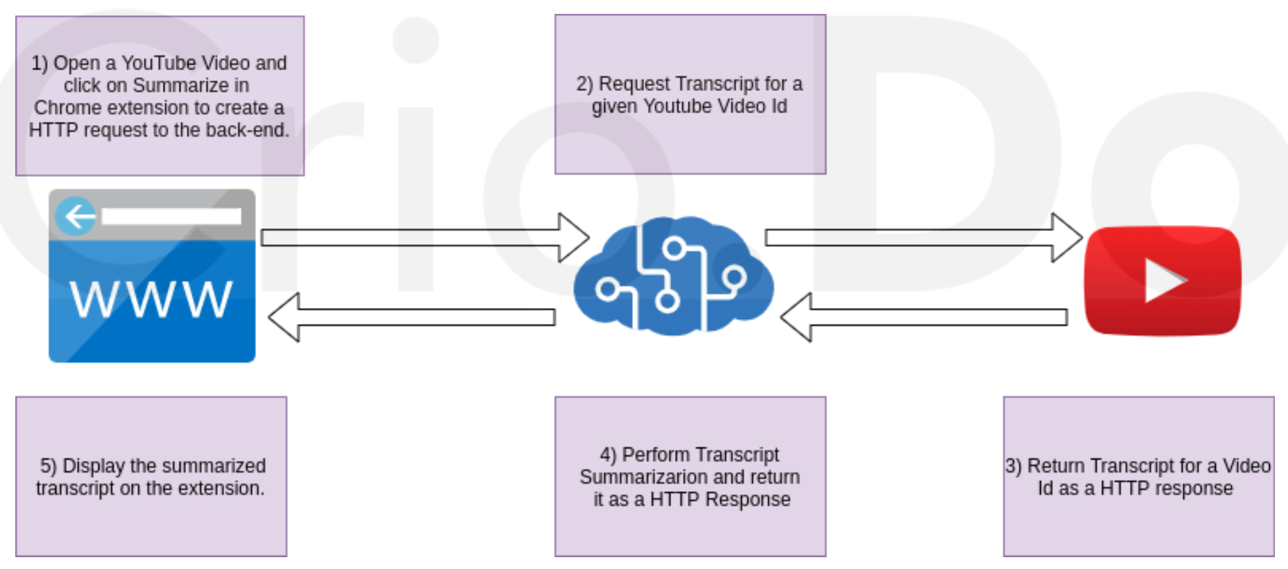
Stages

Slide 6
Features
Summarizes YouTube video transcripts employing advanced NLP techniques.
Utilizes Latent Semantic Analysis (LSA) for extractive summarization of very long transcripts.
Leverages Transformer models for abstractive summarization of shorter transcripts.
Allows the user to adjust the maximum length of the summarized text through dynamic truncation.
Adopts a language-agnostic approach and supports transcript summarization even for videos without subtitles.
Employs an asynchronous XMLHttpRequest to ensure non-blocking communication with the Flask Backend.

Slide 7
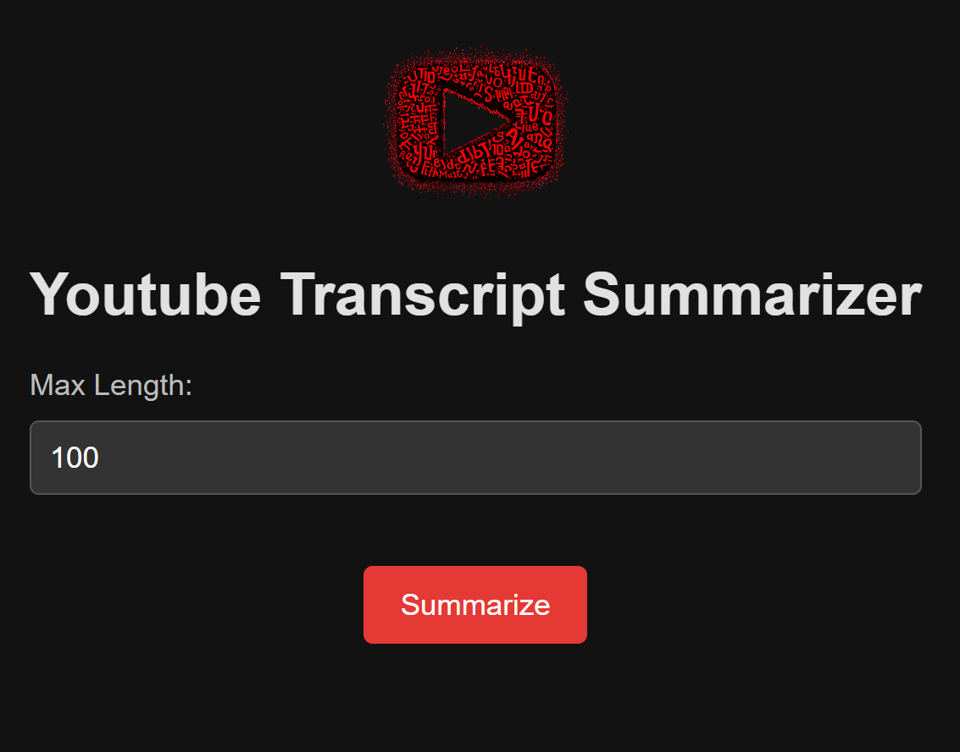
INTERFACE
Chrome extension Popup Interface

Slide 8
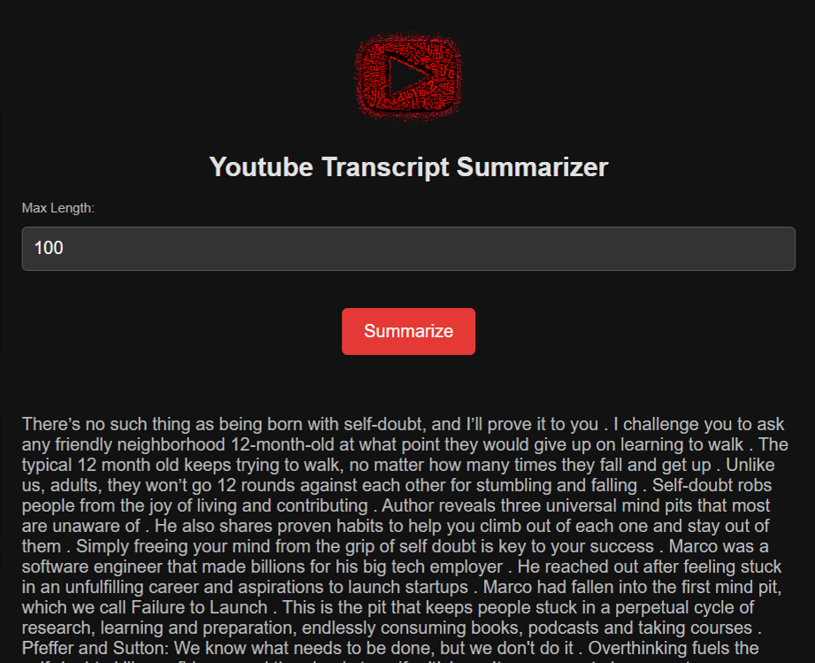
OUTPUT
Output Popup window of summarized text

Slide 9


THANK YOU
Rahul

